Slide 1
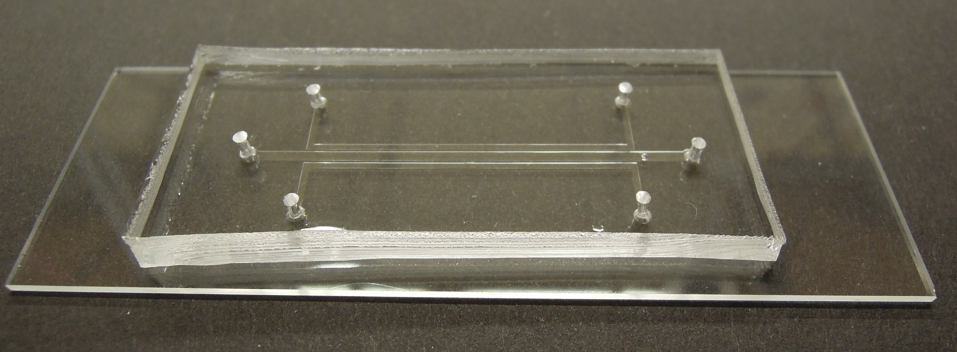

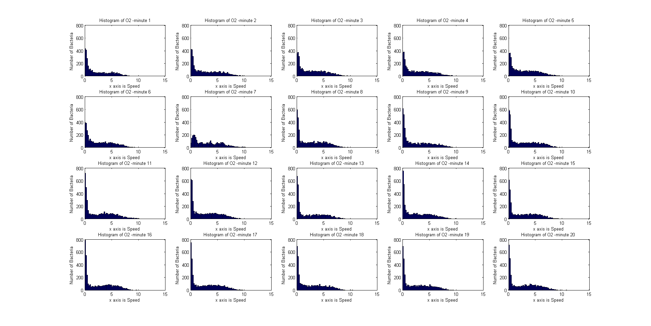
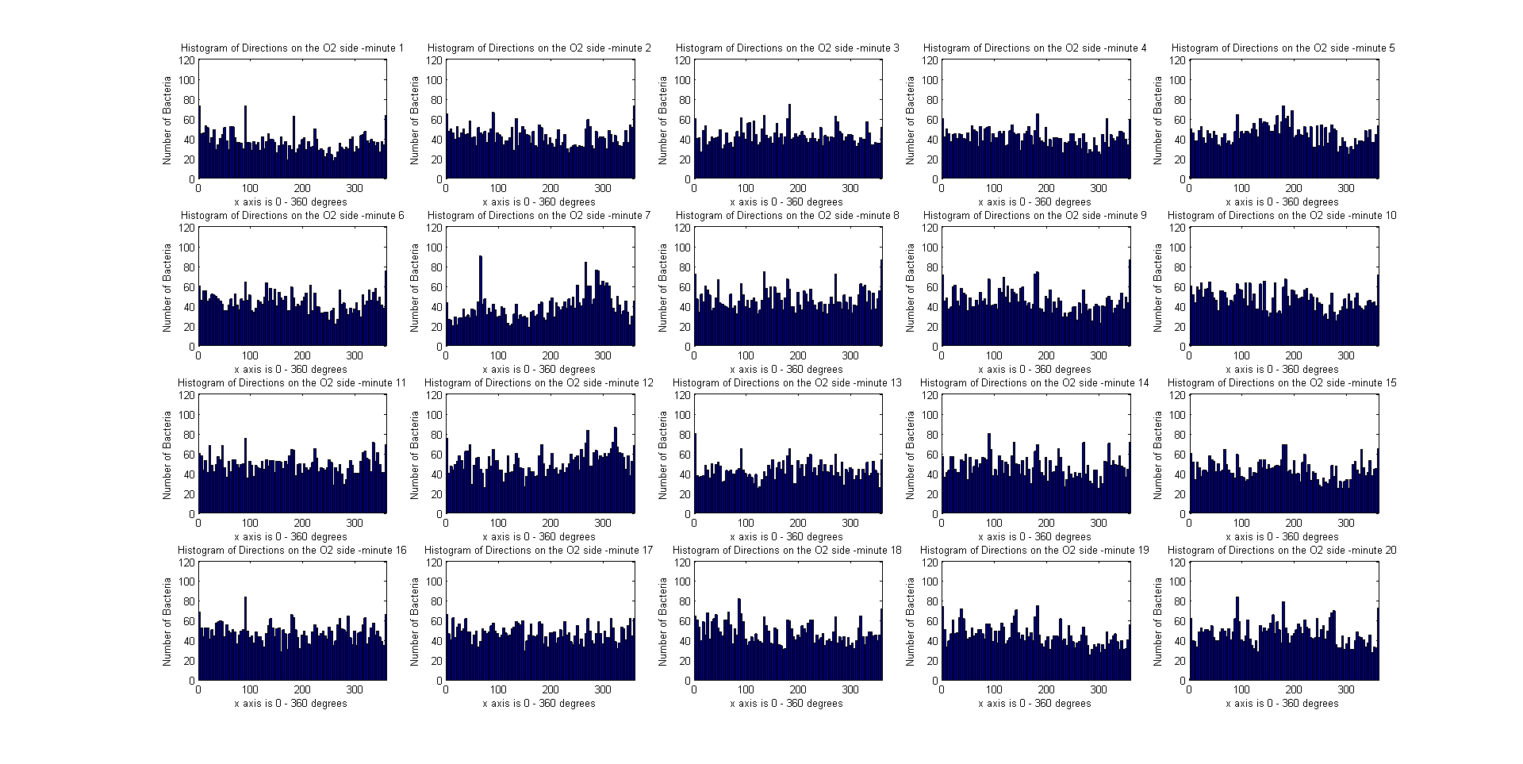
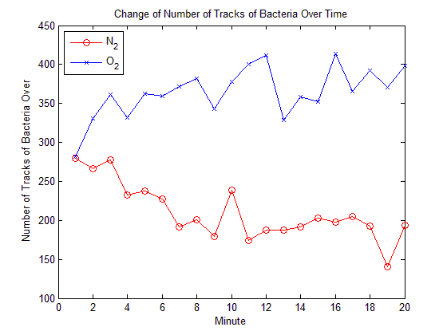
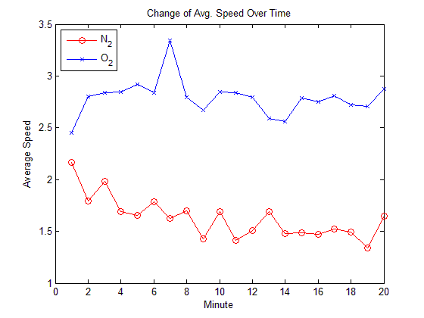
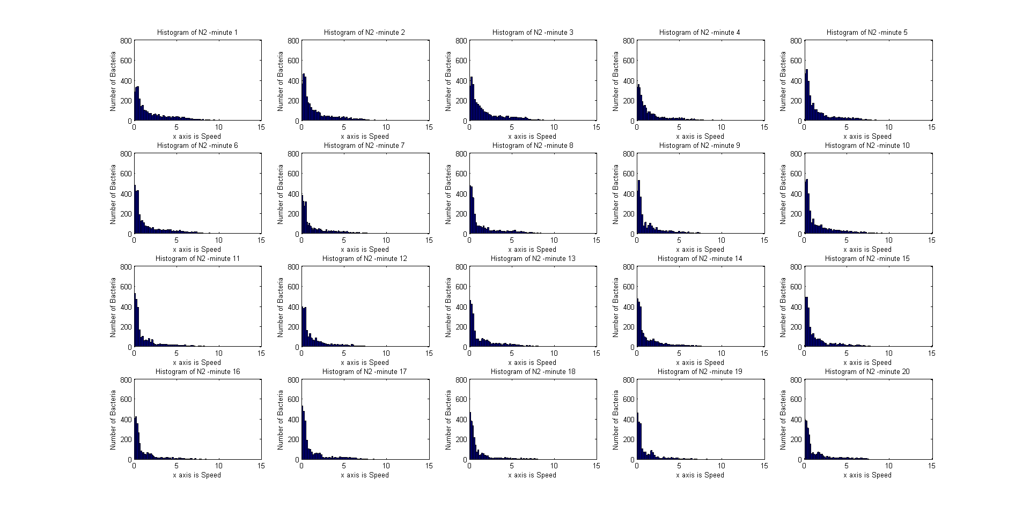

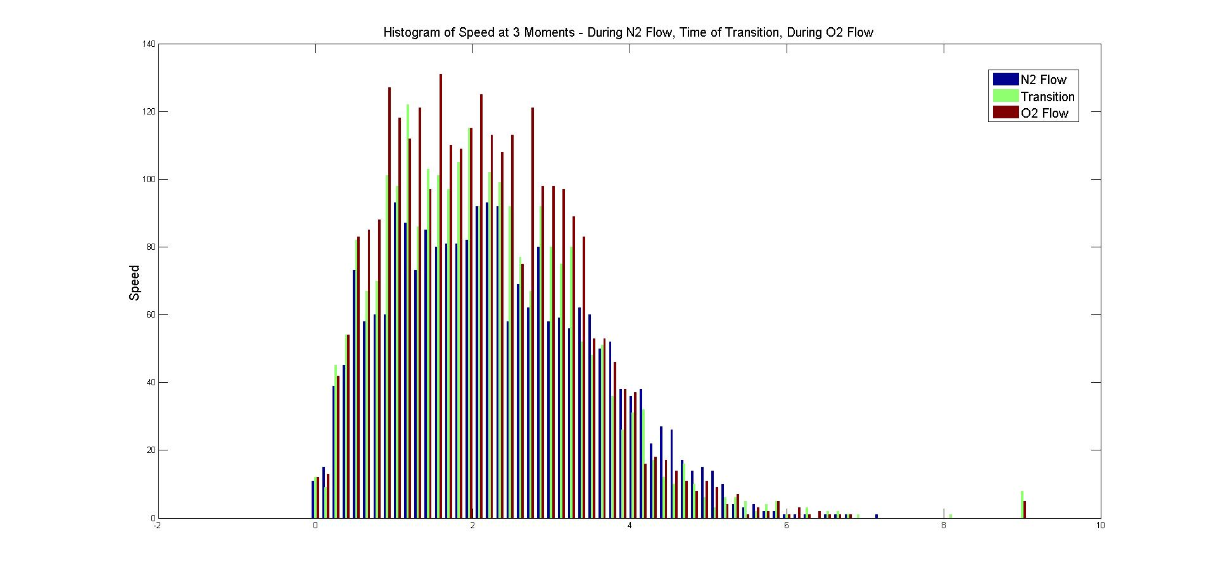
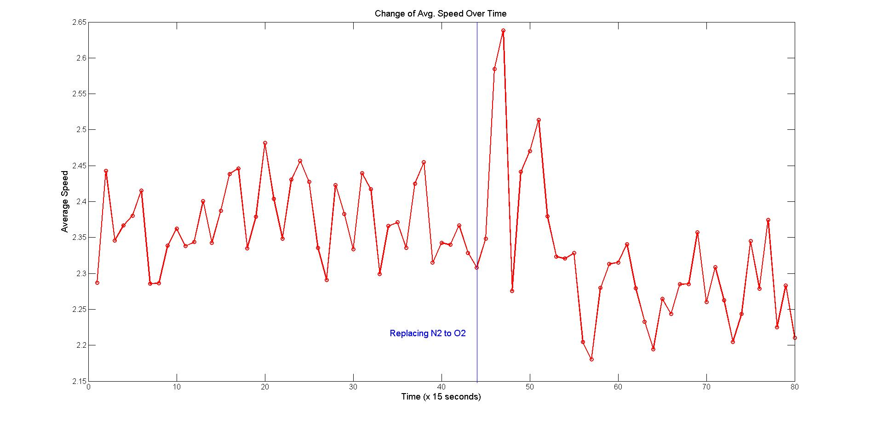
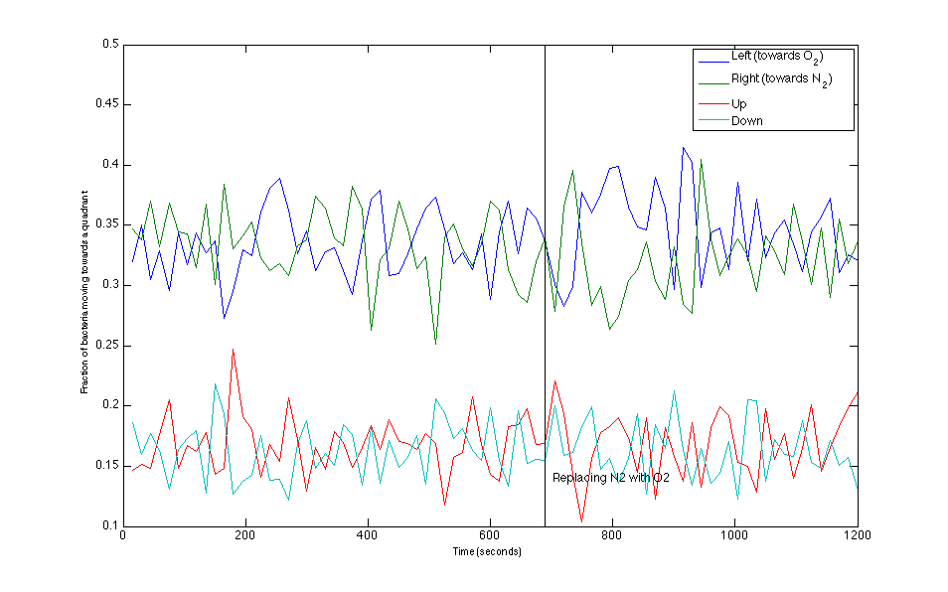
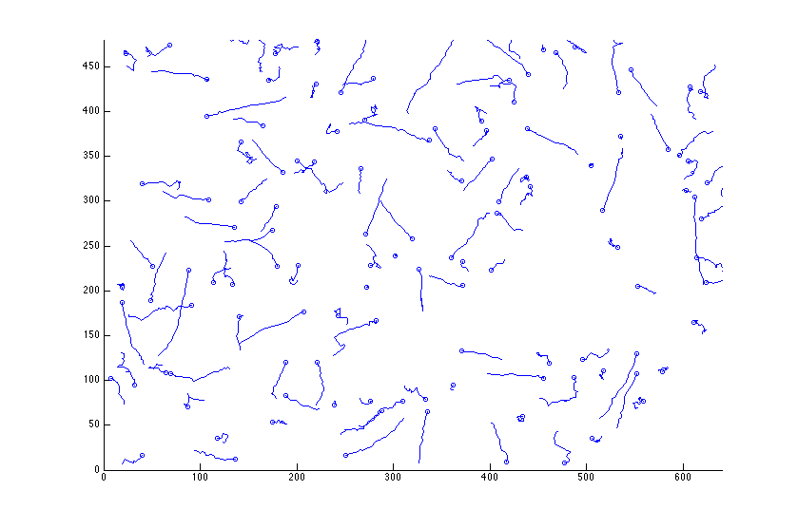
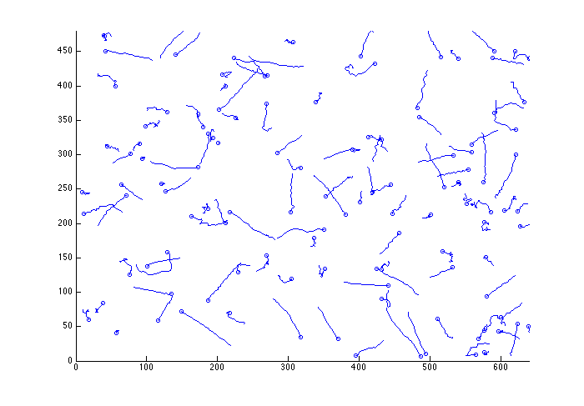
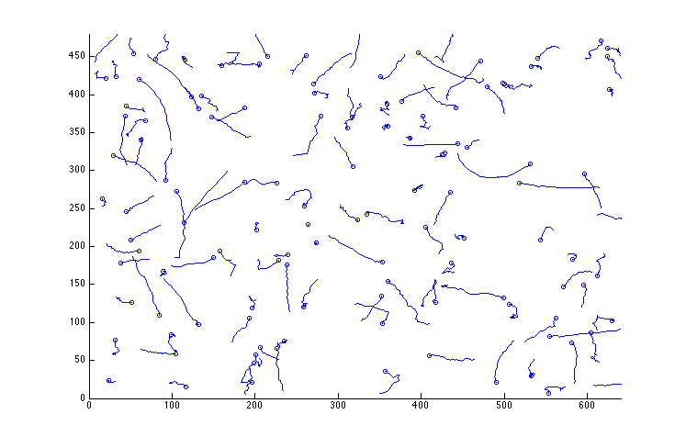
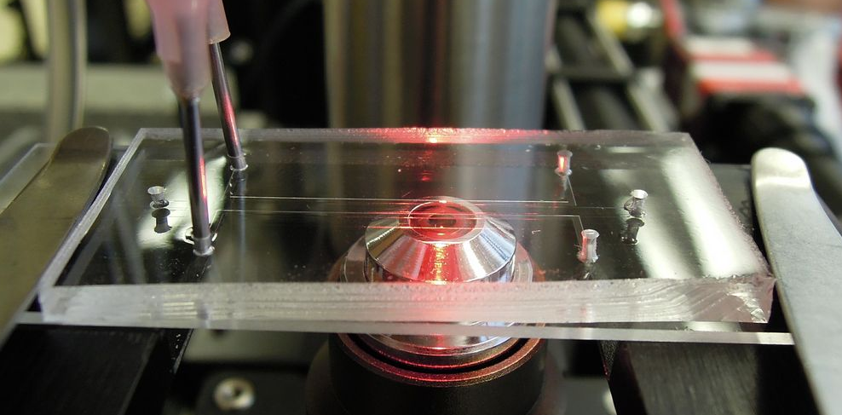
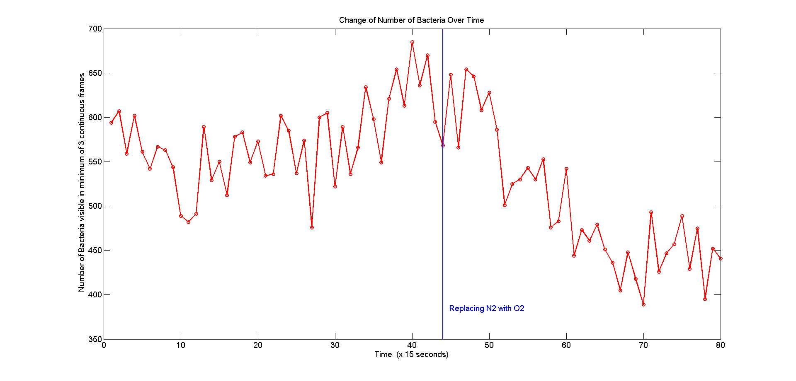
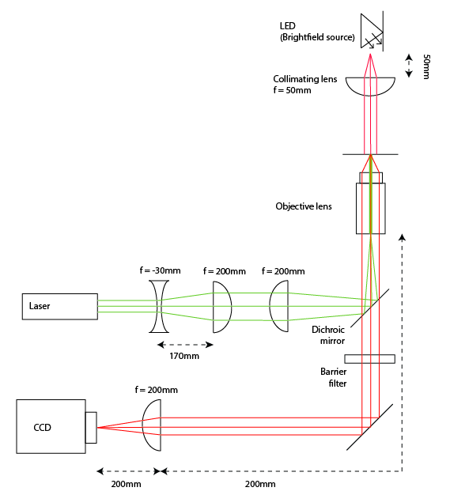
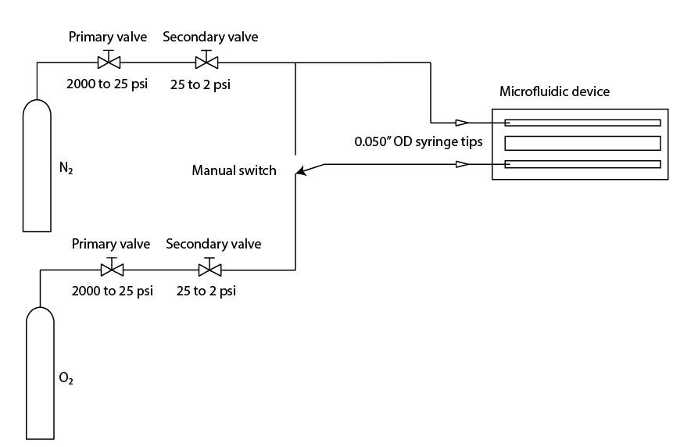
Aerotactic Behavior in B. subtilis
Kiarash Adl, Brian Djaja, Katarina Struckmann, Logan Williams, Filippo Menolascina, Steven Nagle
20.345 Bioinstrumentation Project Lab
Abstract
Results
Bacterial movement is influenced by environmental gradients on all levels of scale. While significant effort has been made to understand responses to chemical gradients, or chemotactic responses, less literature exists characterizing responses to gas gradients, or aerotactic responses. We have developed an apparatus for characterizing aerotactic bacterial motion, based on three microfluidic channels, fabricated from PDMS. We have shown as a proof of concept that the response of B. subtilis to a gradient of nitrogen and oxygen can be observed, through changes in population density. Quantitative analysis of bacterial motion was attempted, but inconclusive due to a high degree of random-walk like behavior.
Experiment 1
30 frames in 1 second has been taken each minute on each side of the channel.
Aerotaxis
Aerotaxis background
Experiment 2
30 frames in 1 second has been taken every15 seconds in the middle of channel
Experiment
Device description
Bacteria description
Prior to oxygen flow
+1 minute
+3 minutes
The microscope used for the project was a standard 4f brightfield microscope based around inverted 200mm Nikon objectives.
Conclusions
Text
N₂ and O₂ gases each flow through two regulators, dropping their pressure to 2 psi before they enter the device through 0.050” OD syringe tips.
Both channels were flushed with N₂ for 11.5 minutes before one channel was switched to a flow of O₂.
Acknowledgments
References
Text
1.
MAY 2013

